Slide 1

Project Title -Seasonal Agriculture Performance Analysis
Student Name :- SHRESTH SHAURYA
College Name :– GOVERNMENT ENGINEERING COLLEGE SHEOHAR
AICTE STU ID : STU6448cef54903f1682493173

Slide 2

PROBLEM STATEMENT
(Agricultural activities are influenced by seasonal variations in environmental conditions, farming practices, resource availability and market conditions. As a result, agricultural performance may differ from one season to another. However, raw agricultural data does not clearly explain how agricultural performance changes across seasons or what patterns can be observed in different seasonal conditions. The problem is to analyze the given agricultural dataset and investigate seasonal differences in agricultural performance by identifying meaningful patterns, trends, relationships and variations within the available data.

Slide 3
Project Description
Project Overview: This project analyses a dataset representing agricultural activities across different seasons, geographical areas, and farming conditions.
Data Scope: The analysis covers farming practices, environmental conditions, crop production, resource usage, and economic performance metrics.
Methodology: The dataset was cleaned and prepared using Python, followed by exploratory data analysis to examine how agricultural performance varies across the Kharif, Rabi, and Zaid seasons.
Core Objective: The primary goal is to identify meaningful seasonal patterns, investigate relationships between environmental conditions and agricultural outcomes, and develop data-driven recommendations

Slide 4

WHO ARE THE END USERS?
Agricultural Stakeholders: Individuals who need to understand variations in agricultural performance and identify important seasonal trends.
Agricultural Planners: Professionals seeking to support evidence-based agricultural planning through data analytics.
Farmers & Researchers: Users needing to understand changing environmental conditions and examine differences in resource usage across different periods.

Slide 5

Technology Used
Python: The core programming language used for the data analytics project.
Pandas: Used to clean and prepare the data for analysis, including handling missing values.
Matplotlib & Seaborn: Utilized to apply appropriate visualization techniques to identify patterns, relationships, and variations within the dataset.
Jupyter Notebook: The development environment used to execute the code and document the complete analysis

Slide 6
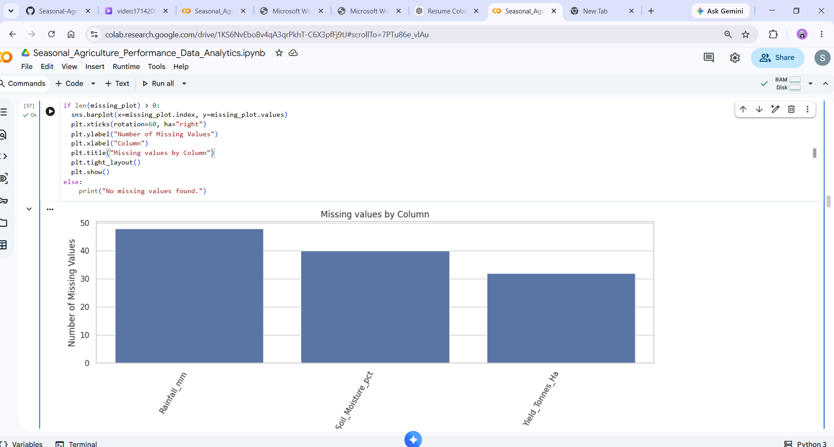
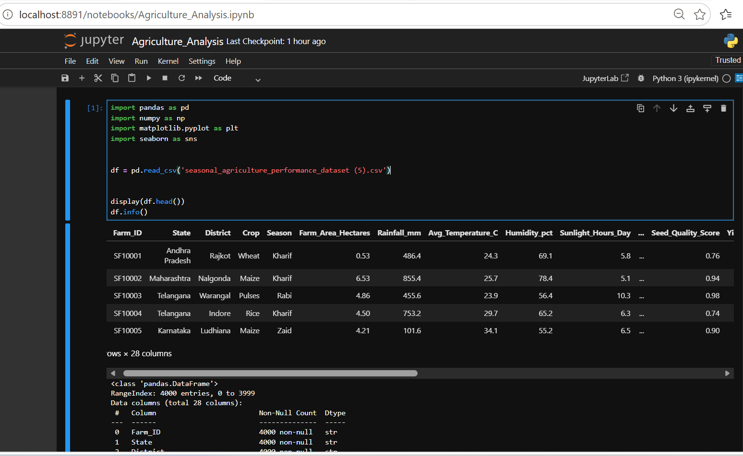
RESULTS

Slide 7
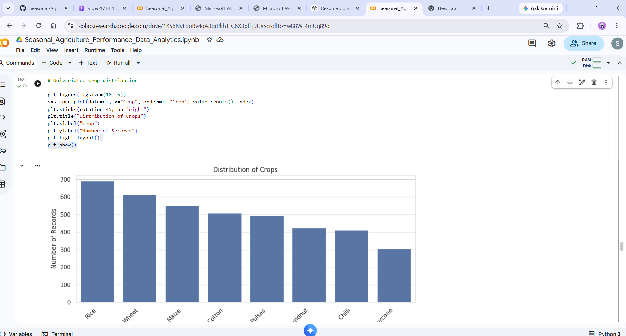
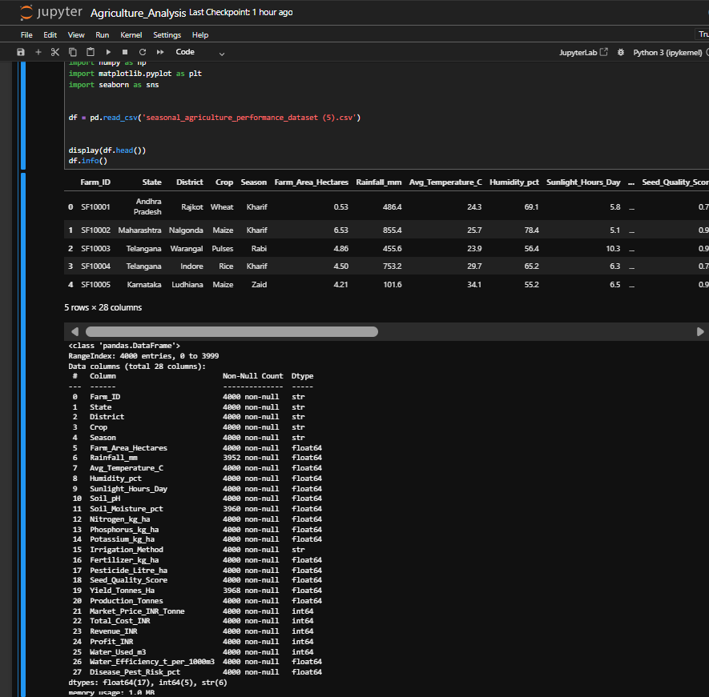
RESULTS
[Add screen shots of your code ]
This is output of result

Slide 8
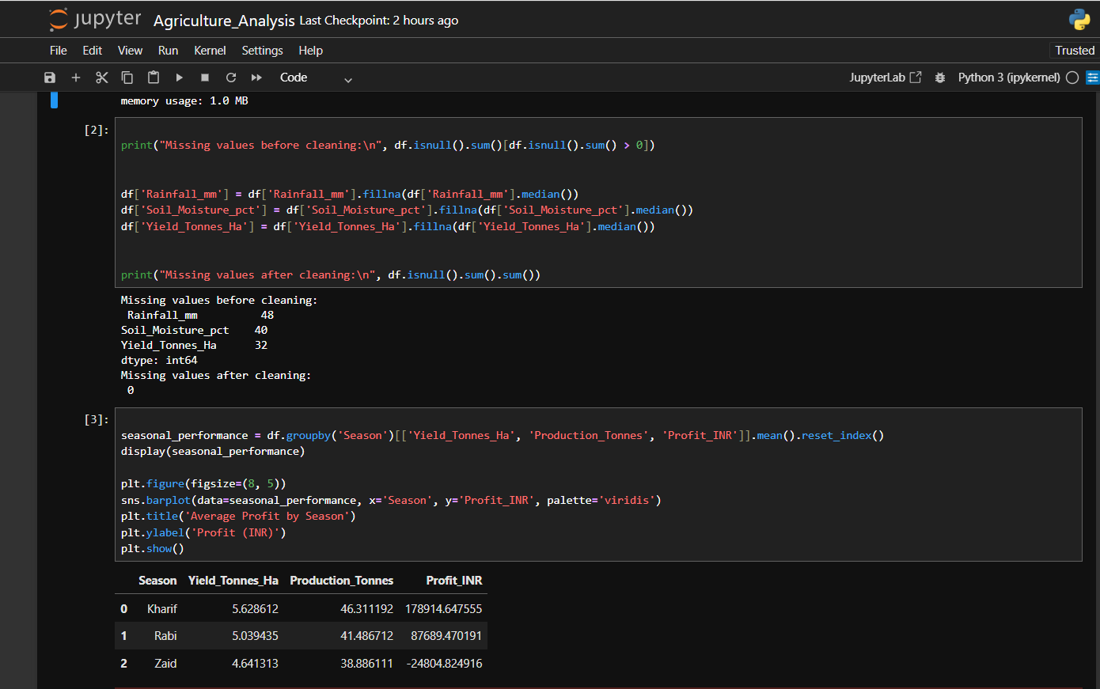
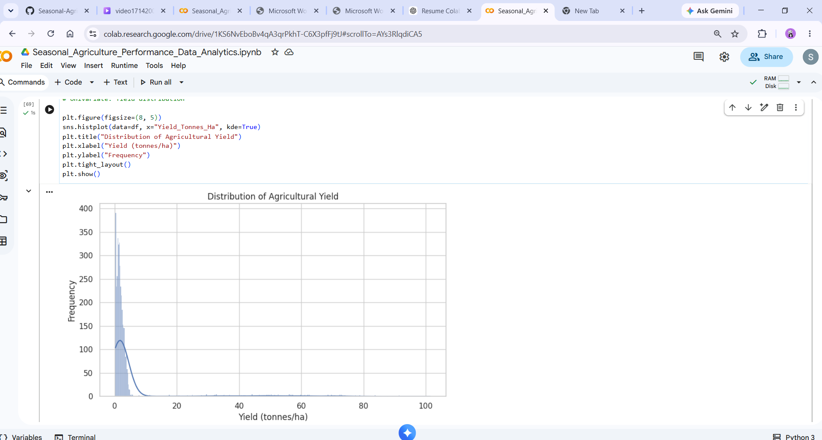
RESULTS
[Add screen shots of your code ]

Slide 9
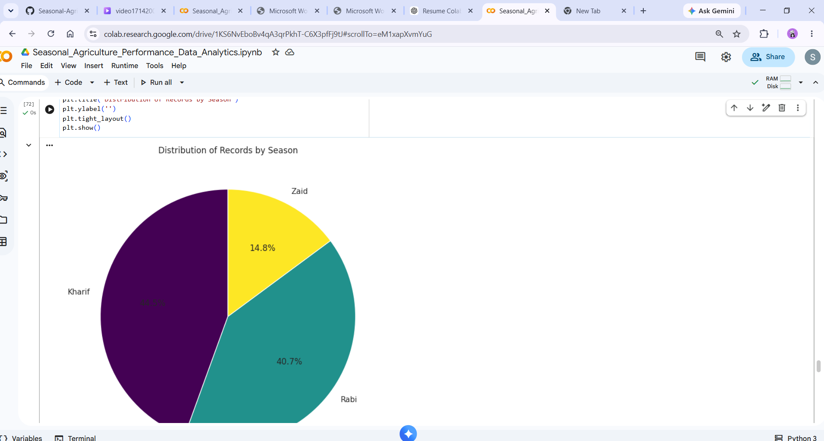
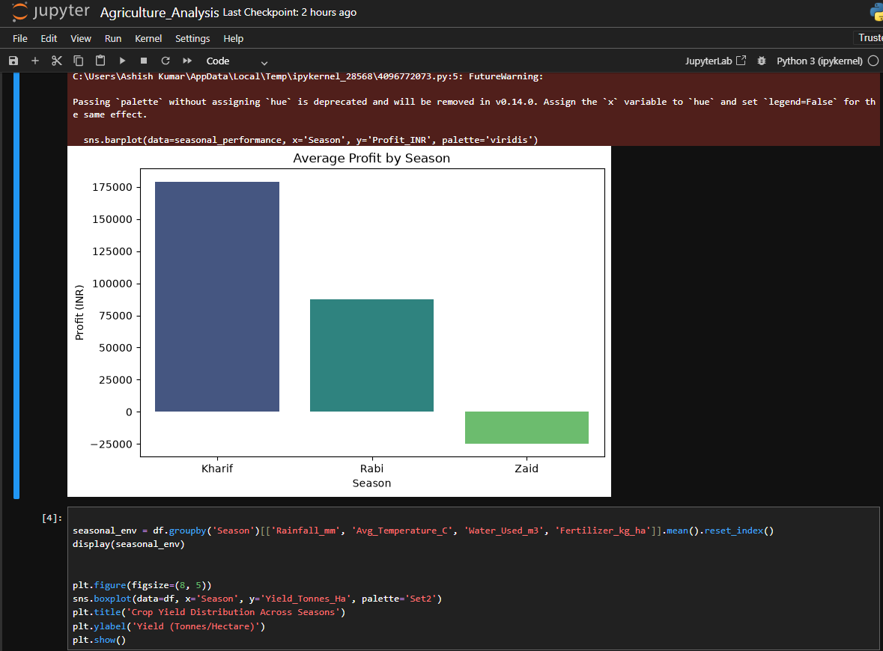
RESULTS
[Add screen shots of your code ]

Slide 10
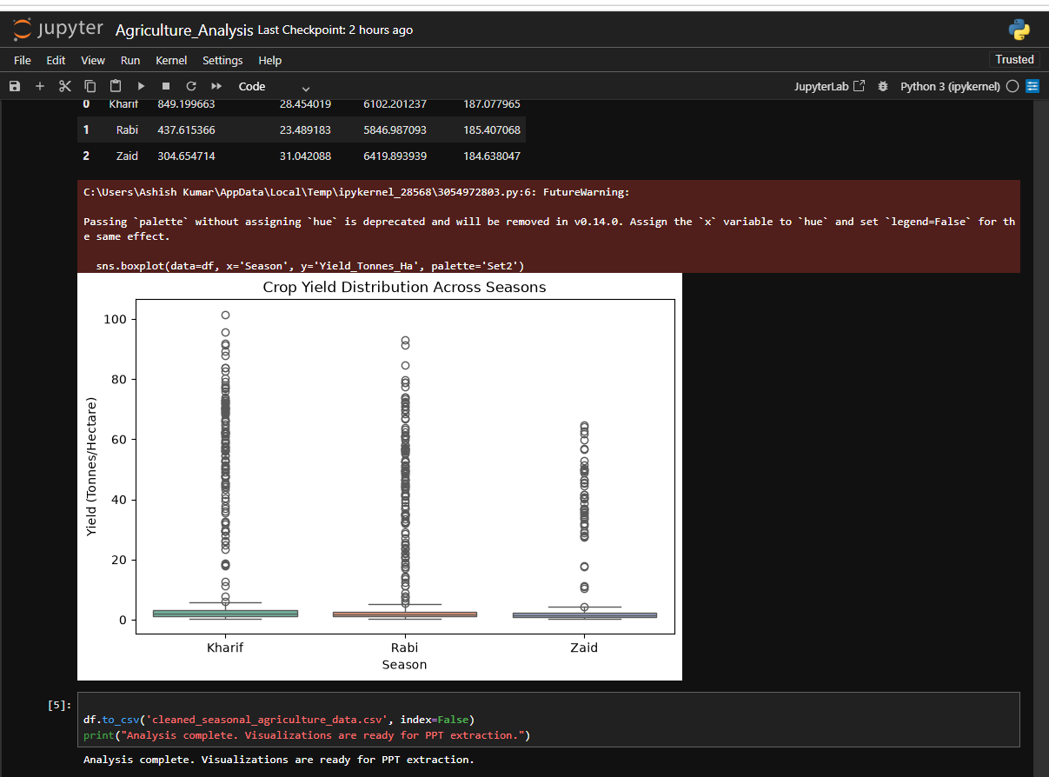
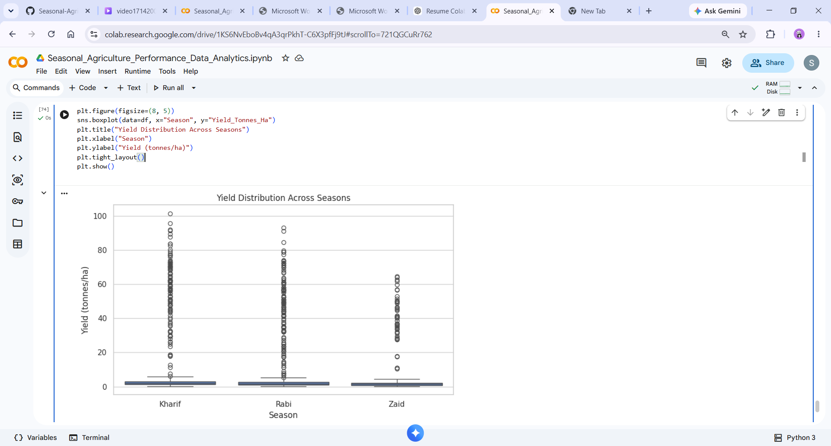
RESULTS
[Add screen shots of your code ]

Slide 11
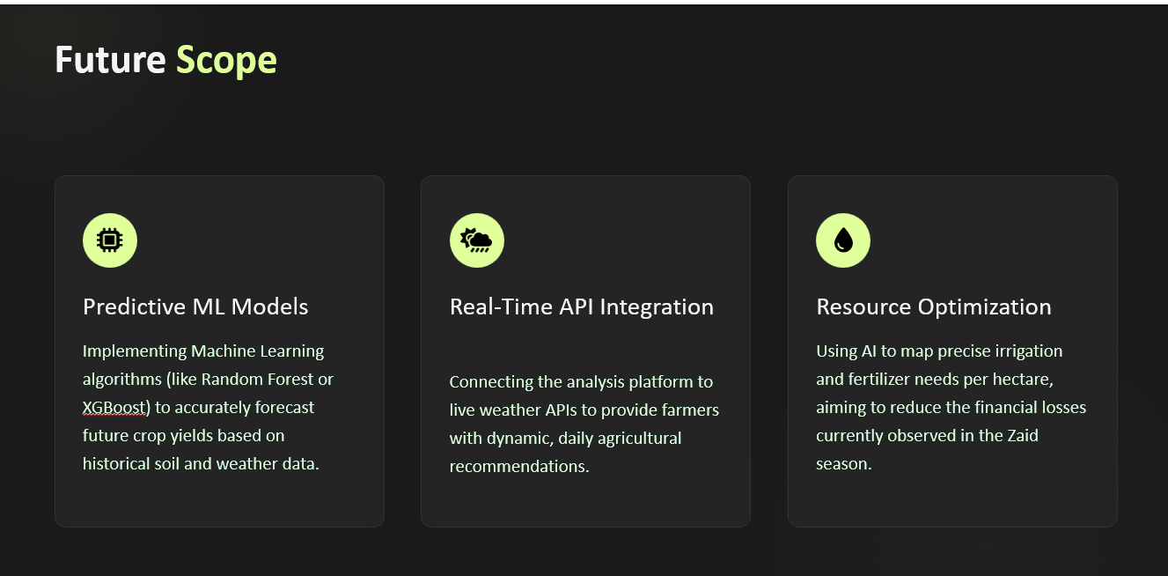
Future scope

Slide 12
GitHub Link
https://github.com/Shresth-16/Seasonal-Agriculture-Performance-Analysis.git

Slide 13

VOIS Course completion certificate -
Course name- Data Visualization

Slide 14
Thank you
.
.

